Slide 1

American Airlines Route Optimization

Slide 2

AGENDA
Objective
Data & Exploratory Analysis
COVID Impact on Market Share
Fare and passenger analysis
Route Optimization
Recommendation

Slide 3

Introduction
Despite record profits, American Airlines' margins have fallen behind competitors United and Delta. We plan to analyze flight routes, fare, and passenger data over the last 10 years to suggest ways to optimize routes and achieve higher efficiencies. We will analyze how airline market shares have shifted before and after COVID. American Airlines current network is focused on the sunbelt, and we will explore opportunities to expand market share in North and West regions.
We will evaluate flight distance, destinations, fares, and market share in markets across the country to optimize operations and expand market share.

Slide 4
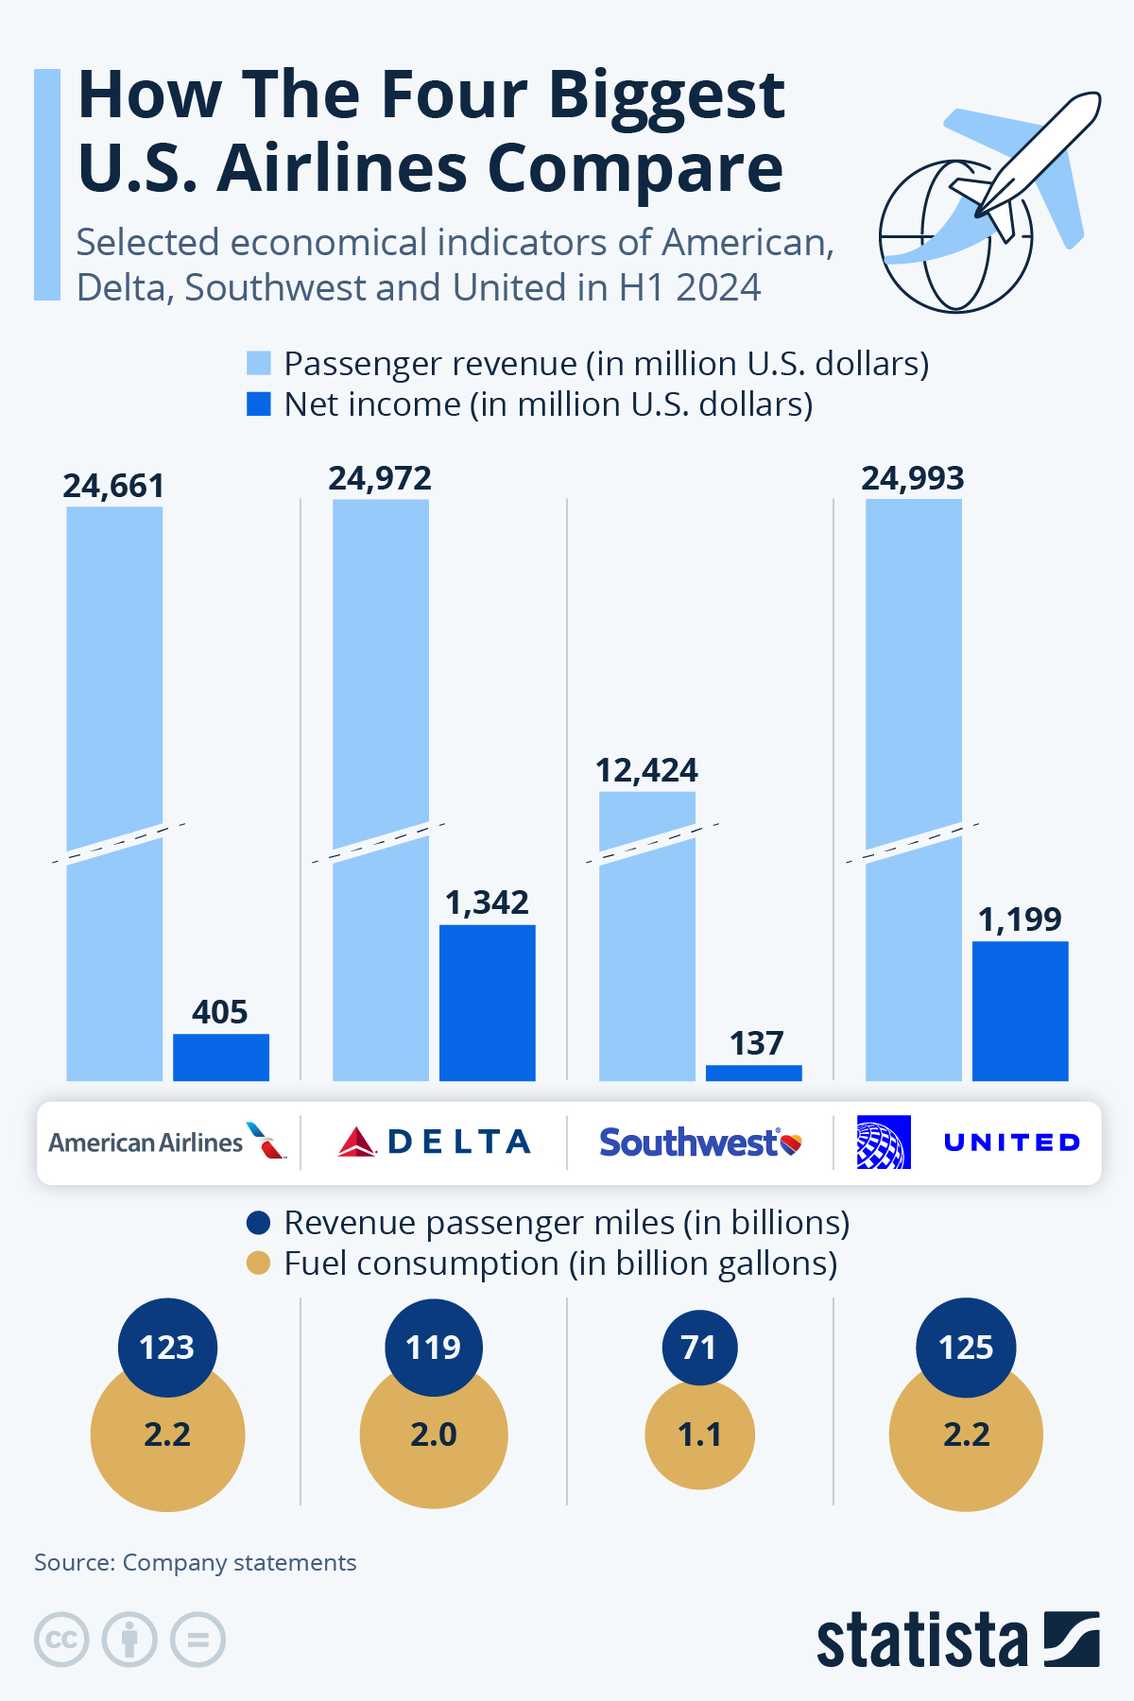
Project Scope
American is the largest airline in the United States, but net income falls 3-4% below top competitors Delta and United. Fuel efficiencies are comparable across top four airlines.
The top factors we will explore:
COVID impact on market share
Optimizing existing routes and routing through current hubs
Expanding coverage to new routes utilizing current hubs
Competitive fare analysis
Important factors beyond the scope of this project:
International networks
Domestic overcapacity
Operating expenses
Distribution channels
Code sharing
https://www.statista.com/chart/32723/selected-economical-indicators-of-american-delta-southwest-and-united/

Slide 5
Data Set
We utilized four datasets for our project: fuel_rates Dataset This contains information about fuel usage and rates associated with airline operations. The focus is on fuel-related metrics over different airlines and time periods.
Admin_mail Dataset This includes administrative costs and mail-handling data for airlines during specified seasons.
Merged_data Dataset This is a comprehensive dataset that includes operational, financial, and geographic information about airlines. It offers a wide overview of airline performance measures.
Cleaned Dataset This focuses on route-specific details including prices, passengers, and distances between city pairs. It gives information on airline competitiveness at the route level.

Slide 6
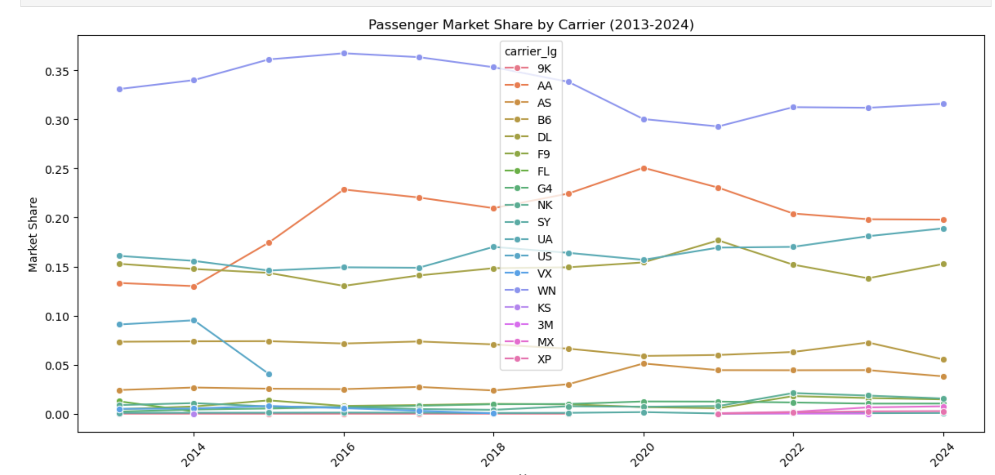
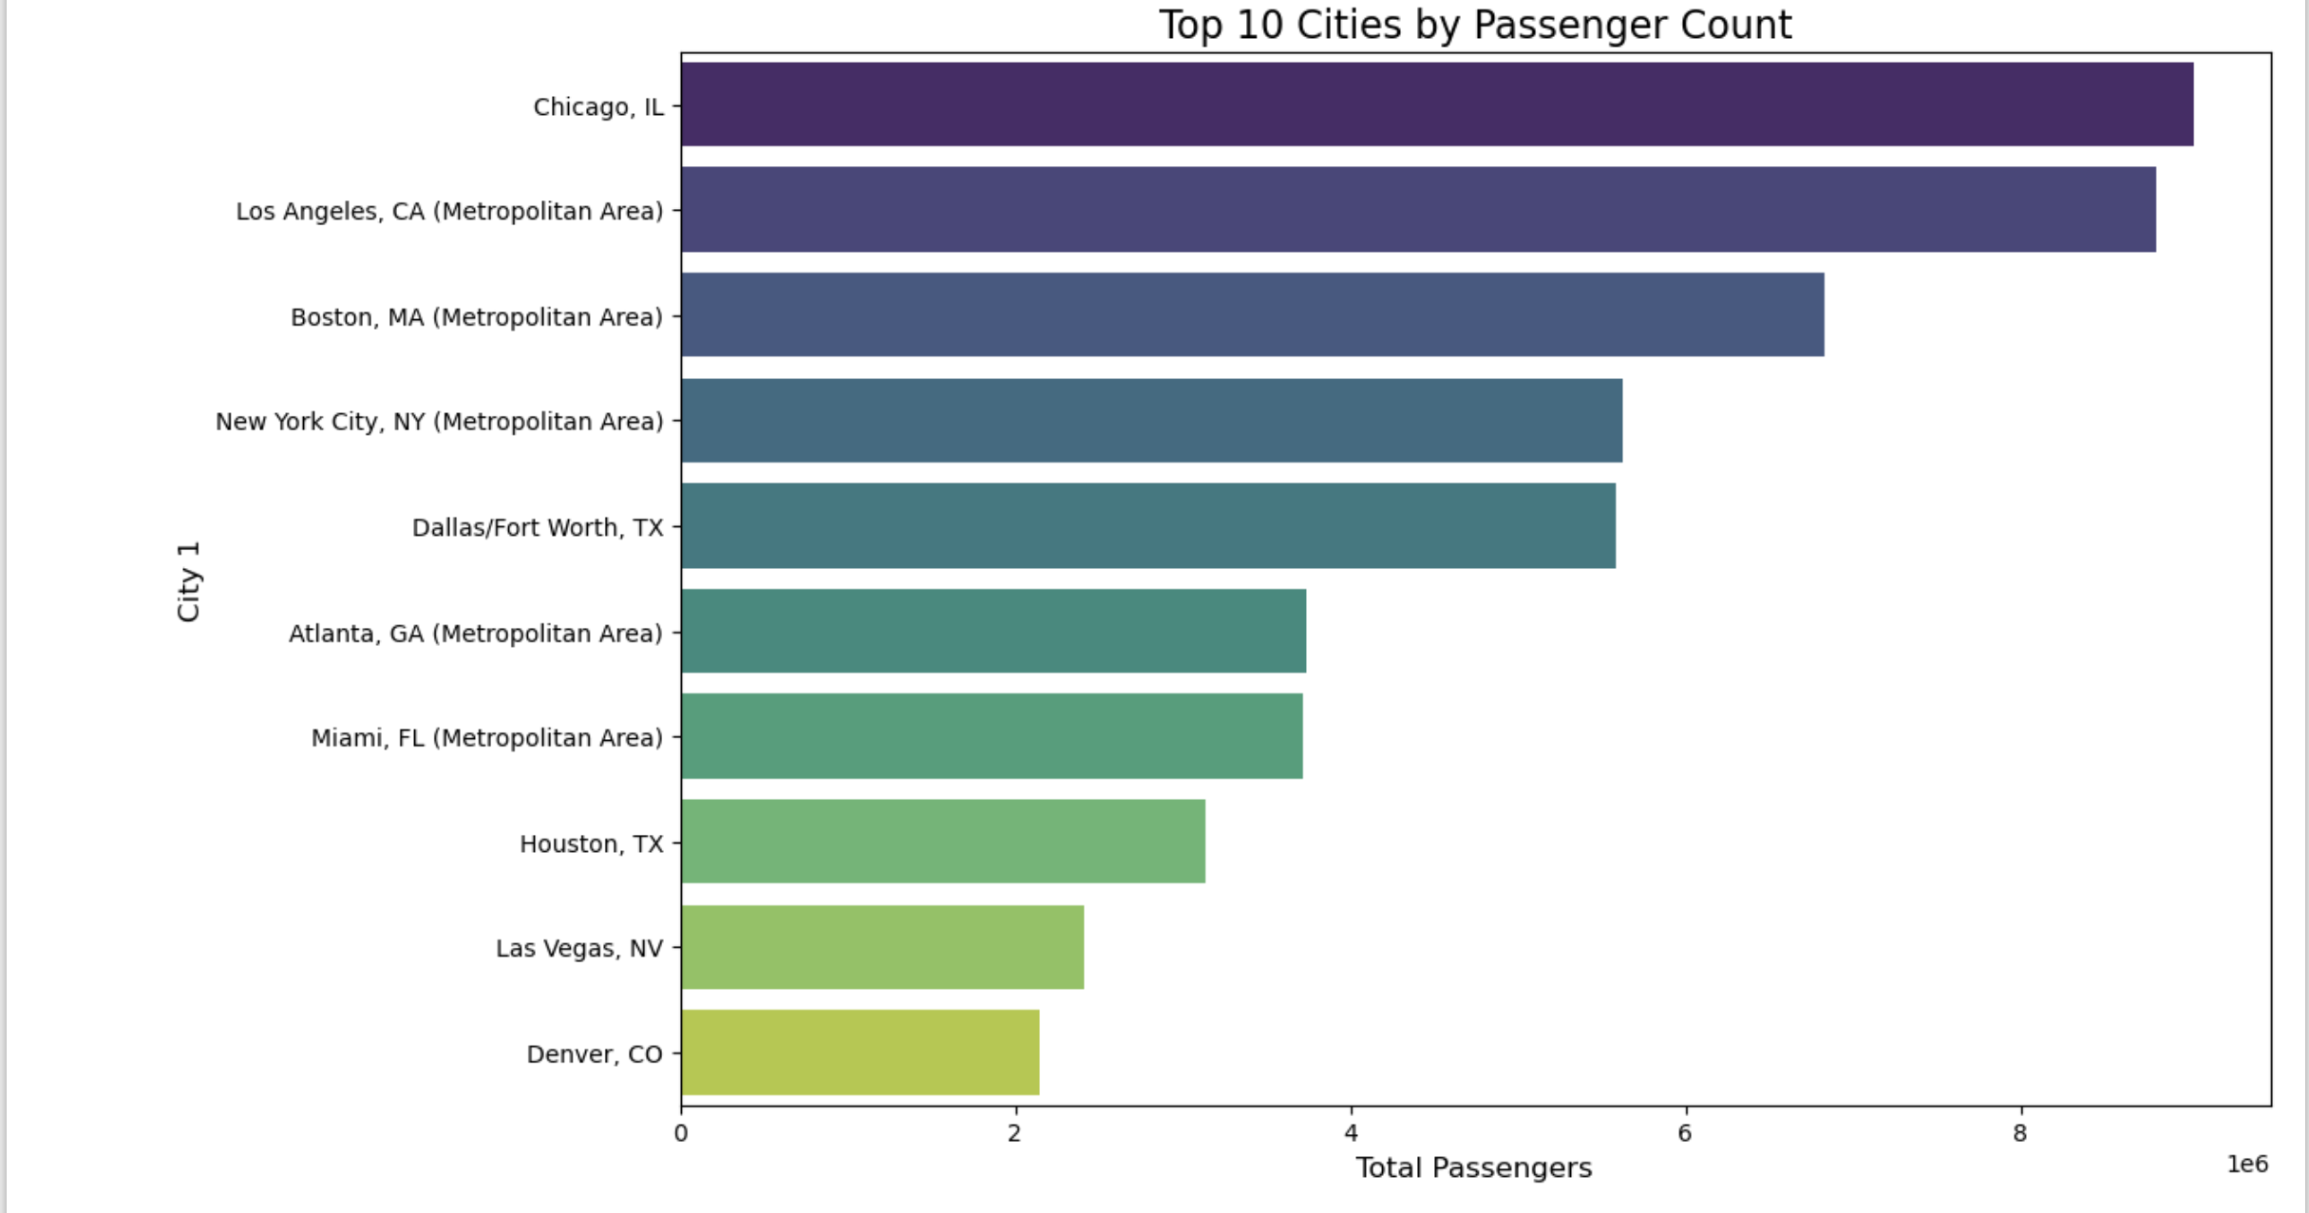
Exploratory Data Analysis

Slide 7
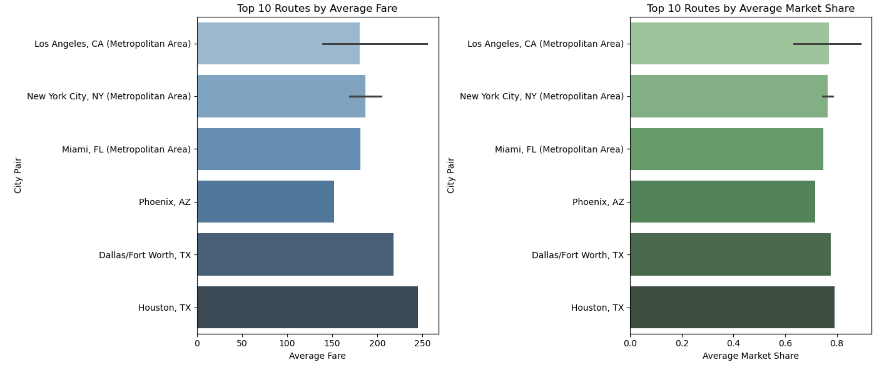
Exploratory Data Analysis

Slide 8

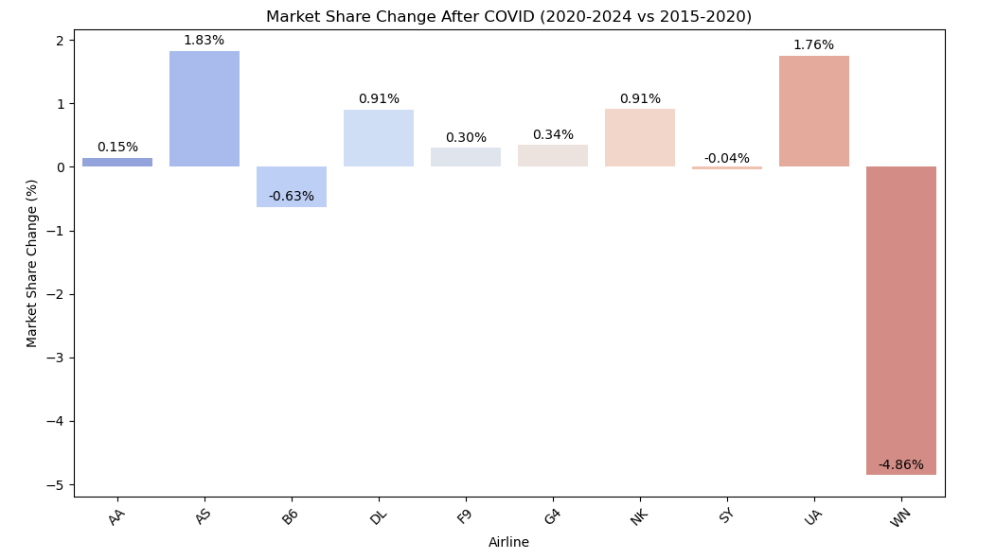
COVID Impact
Across the Airline Industry
AA – American; AS – Alaska; B6 – JetBlue; DL - Delta; F9 – Frontier; G4 - Allegiant; NK – Spirit; SY – Sun Country; UA – United; WN - Southwest
https://pmc.ncbi.nlm.nih.gov/articles/PMC9640395/
Notes:
In 2020 the number of airline passengers dropped by 60%. Domestically, demand decreased by about half. Despite the catastrophic effect of COVID on the airline industry, most airlines have rebounded almost completely.

Slide 9
Fare and passengers analysis
Passenger Impact: Both large and low-cost carriers show a minimal negative correlation between the number of passengers and market share, highlighting limited practical influence.
Fare Sensitivity: Higher fares significantly reduce market share, with low-cost carriers being more negatively impacted compared to large carriers.
Market Overlap: A moderate positive correlation (r = 0.528) exists between large and low-cost carriers' market shares, indicating potential competition in overlapping markets.
Practical Implications: Price optimization is essential, especially for low-cost carriers, to maintain market share. Passenger volume shows minimal practical impact on market share, suggesting a focus on other factors like service quality or network expansion.

Slide 10

Beyond the Sunbelt
Rising air travel demand is fueling growth in cities beyond the Sunbelt.
Emerging hubs like Denver, Chicago, and Seattle are investing in major transportation infrastructure.
Air traffic growth in these regions is projected to exceed 80%.
Route optimization reduces travel times and enhances connectivity for business and leisure travelers.
New hubs offer more efficient and cost-effective travel solutions.
Reduced congestion in traditional Sunbelt cities due to shifting travel patterns.
These cities are set to become key players in the future of air travel.

Slide 11
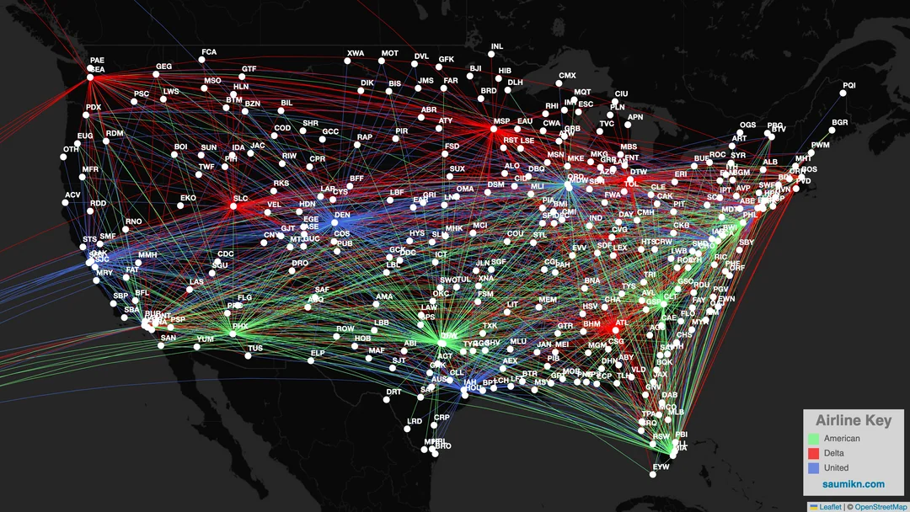
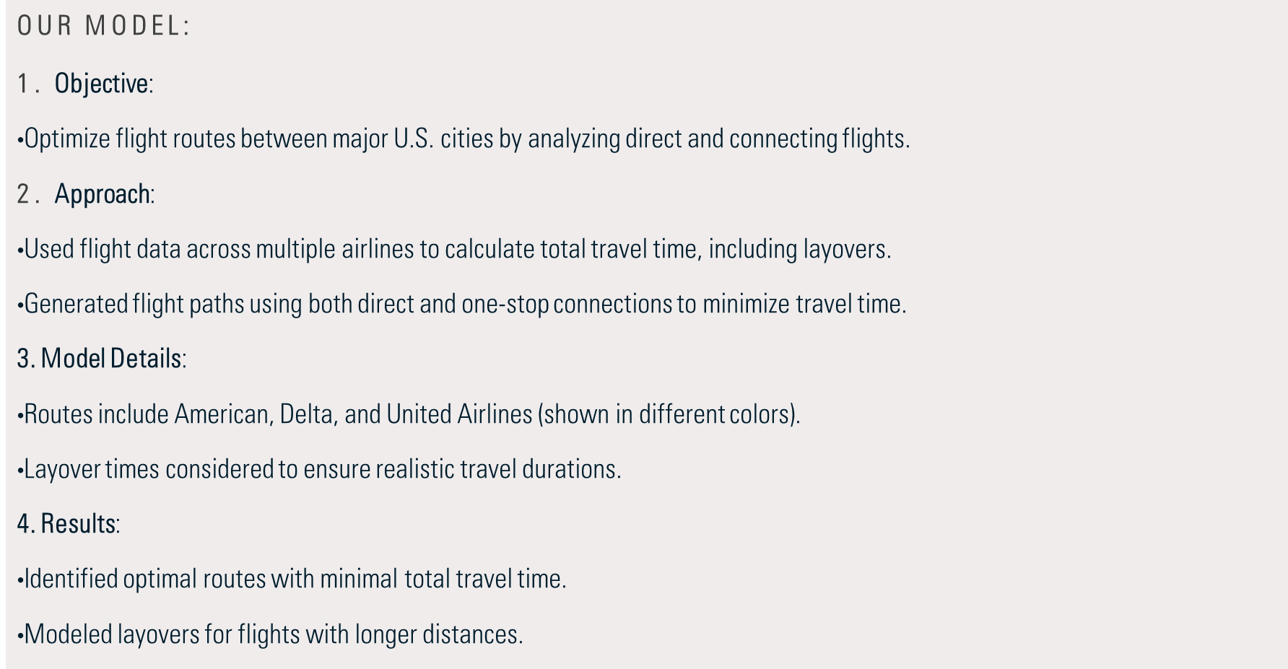
Route Optimization
Notes:
We built a directed graph to represent flight connections between cities, ensuring the correct mapping of city names from the dataset to avoid discrepancies.
The solution integrates both direct and layover routes, calculating important metrics like flight time, operational costs (crew, fuel, maintenance, and airport fees), revenue, and profitability for each route. We implemented a comparison system that evaluates the shortest route and multiple layover routes based on profitability and travel time, with robust handling for cases where no direct path exists between cities. The entire process includes visualization of the most profitable routes, allowing for insights into route optimization and potential improvements for American Airlines

Slide 12
Findings
Double-Down Strengthen current hubs in sunbelt region and add routes to underserved markets.
Layovers Developed model to incorporate American Airlines hubs into routes to Northeast and Western regions. Limited layover time to reduce travel time, with potential to lower fares.
Fare Focus Refining pricing strategies, including higher fares during peak seasons and 1.5x normal fare for bookings within 5 days of travel.

Slide 13
Challenges
Redundant Layovers
Layover cities being too close to the start or end destinations, making connections inefficient.
Balancing Pricing and Profitability
Difficulty in offering customer-friendly fares while ensuring profitability for all routes.
Inaccurate Cost Estimations
Challenges in estimating realistic fuel and airport charges, leading to potential miscalculations of profitability.
Regional Connectivity Issues
Ensuring strong connectivity within the Sunbelt region while expanding access to other parts of the U.S.

Slide 14
TAKEAWAYS
Expand Currently focused on domestic airports in the USA, with plans to expand research and analysis globally in the future.
Sentiment Further refining pricing strategies, taking customer sentiment into account for any price increases and low fare trade-offs
Partners Incorporate code share partners and alliances to analysis.
Efficiency Optimizing fuel usage and fare pricing to enhance sustainability and profitability.

Slide 15

THANK YOU
Team Five
BUAN6390

